Slide 1
Nerves and Neurons

Slide 2
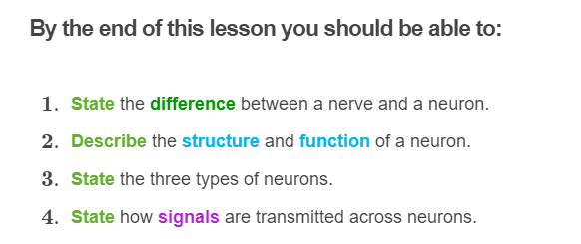
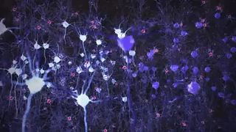

Slide 3
The most basic component of your nervous system are nerve cells, called neurons!
Neurons have a very long lifespan since if they die, they cannot be replaced. There are around 100 billion of these neurons in your brain alone!
A neuron is a specialised cell whose function is to receive and transmit information from all around the body, to other neurons, muscles or glands.
Neurons use both electrical and chemical impulses to do this.

Slide 4
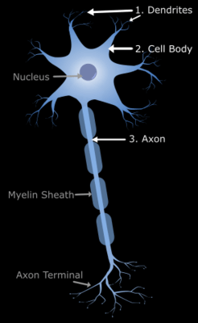
The three parts of a neuron:
Although different types of neurons can look structurally different, a typical neuron is made up of three main parts. These are the dendrites, cell body and the axon.
Neurons send electrical impulses (nerve impulses) along the neuron in one direction only - from the dendrites, cell body and then through the axon.
These three parts of the neuron have different roles that all work together to ensure that information is transmitted from one neuron to another.

Slide 5
Dendrites
Dendrites are the branch-like extensions found at the top of the neuron and branch off from the cell body.
These extensions are highly sensitive and have lots of receptors on its surface which allow it to receive chemical signals (or neurotransmitters) from other neurons and then transmit the electrical information down the axon of the neuron.

Slide 6
Cell body
The cell body is the main part of the neuron which contains all of the necessary components like the nucleus, ribosomes, mitochondria and other organelles that help to keep the nerve cell alive.
The main function of the cell body is to keep the neuron functional. If the cell body does not work, then the rest of the neuron cannot work either and the neuron will die.

Slide 7
Axon
The axon is the long cable-like projection of the cell that carries the electrical message down its length, toward the axon terminal (the end of the axon).
Axons are usually covered with thin layer of substance called myelin sheath. Myelin is made of fat and protein, and it helps to insulate and increase the speed that an electrical impulse is transmitted down the axon towards the axon terminal.

Slide 8
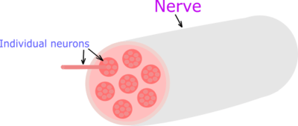
Nerves vs Neurons
We know that the smallest component of the nervous system are nerve cells, called neurons. When the axons of these neurons are grouped together, this forms nerves.
It is important to remember that neurons are a single nerve cell, but nerves are a group of neurons connected together.
Nerves are what make up the peripheral nervous system. These nerves are connected to all the muscles in your body and connect them back to the brain and spinal cord.

Slide 9
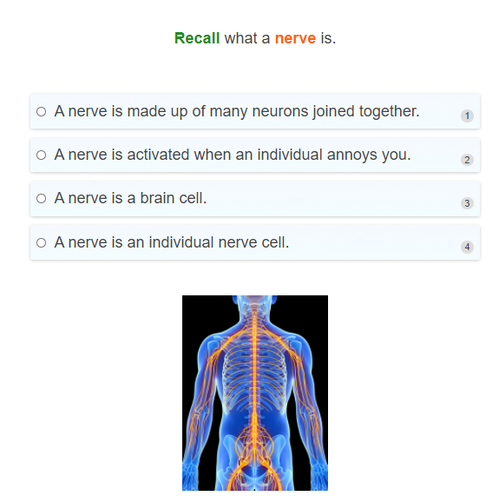

Slide 10
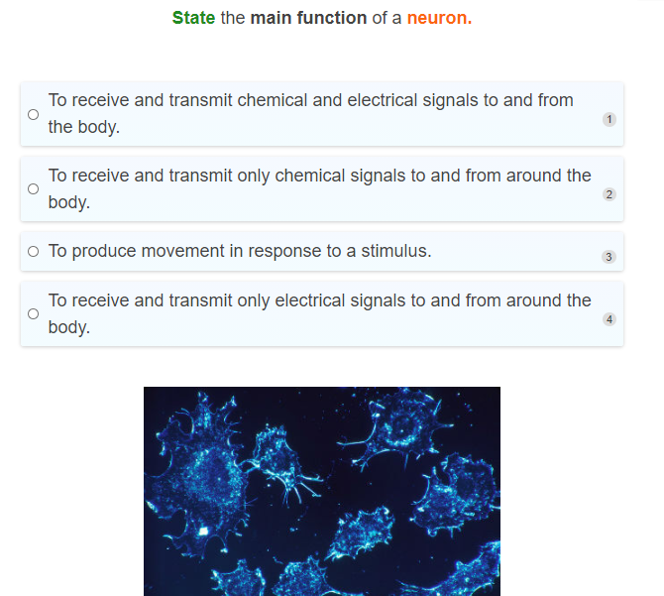

Slide 11
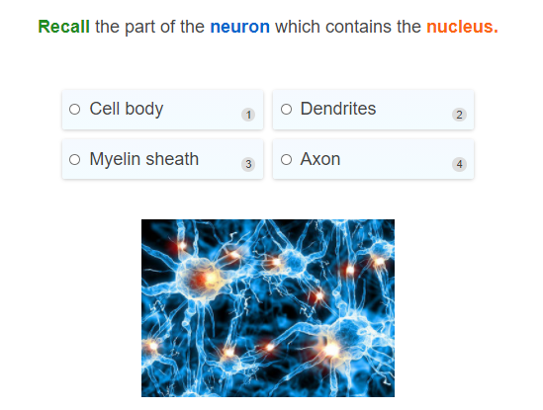

Slide 12
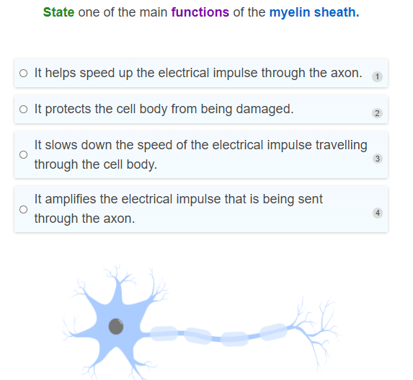

Slide 13
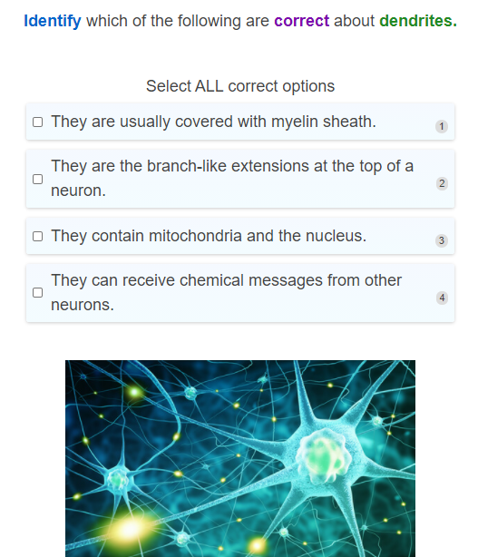

Slide 14
There are three different types of neurons!
1. | Sensory neurons
2. | Motor neurons
3. | Interneurons

Slide 15
Sensory neurons
1. Sensory neurons convert external stimuli that it receives from your senses (smell, taste, sight, touch, and hearing) into electrical impulses that it sends toward the central nervous system (the brain and spinal cord).
For example, your sensory neurons are the ones that receive information from the sensory receptors in your skin about that spider crawling on your hand, and send an electrical impulse to the central nervous system about it.

Slide 16
Sensory neurons II
These neurons transmit sensory information and are activated by sensory input. They convey this information to the brain or spinal cord, where this information is processed and a response is made.
Sensory neurons send information from our senses to our brain or spinal cord.

Slide 17
Motor neurons
Motor neurons carry information away from the brain or spinal cord to the effectors, such as a muscle or a gland, to produce a response.
Motor neurons are what result in the actual movement of your hand to shake away that spider.
Remember that motor neurons produce movement.

Slide 18
Interneurons
Interneurons, or intermediate neurons, are found in the spinal cord and the brain, and carry electrical impulses through the spinal cord and the brain.
These neurons decide what to do and pass on the information it receives from the sensory neurons to the motor neurons.

Slide 19
So how do all these types of neurons work together to get your body to respond to an environmental cue?
Let's imagine that you've accidentally pricked yourself with something sharp, like a nail. Ow!
Sensory neurons receive signals from the receptors on your hand and electrical impulses are sent through sensory neurons to the spinal cord and brain which passes this signal onto the interneurons in the brain which decides what to do.
A signal is then sent to the motor neurons which produce the response, like quickly moving away from that nail.

Slide 20
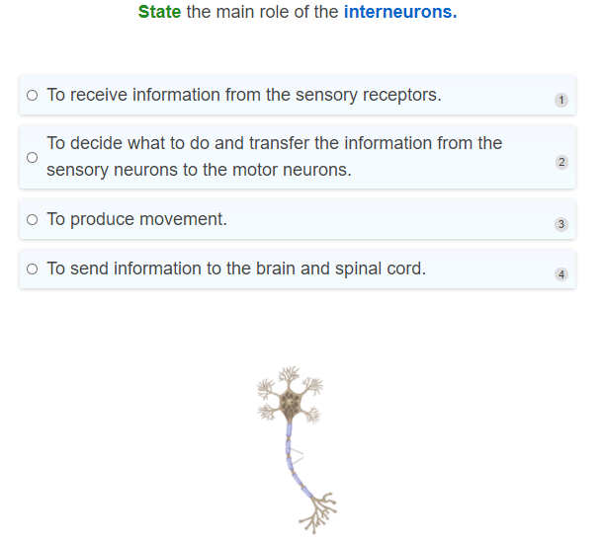

Slide 21
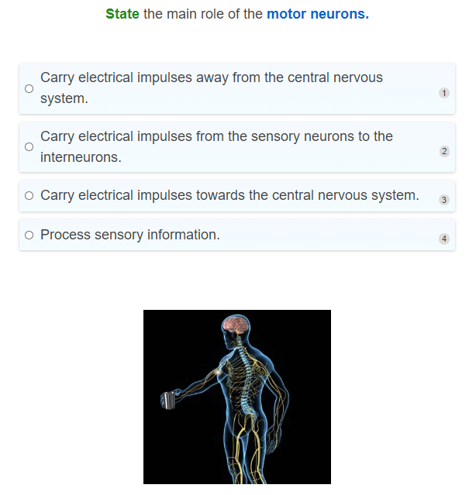

Slide 22
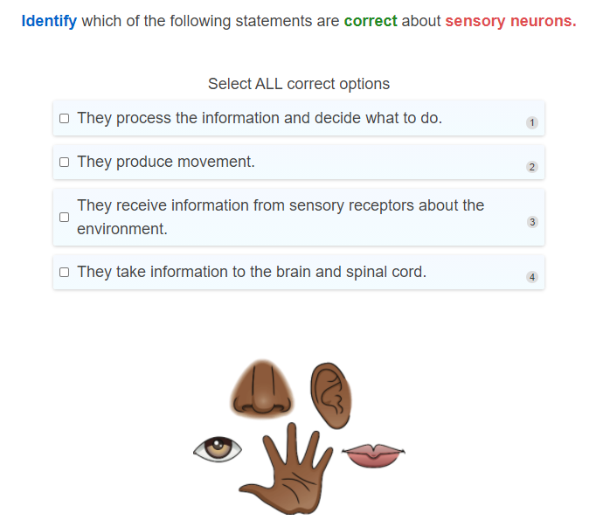

Slide 23
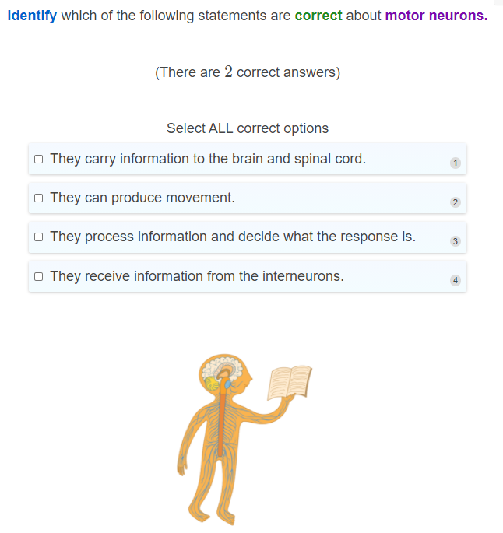

Slide 24
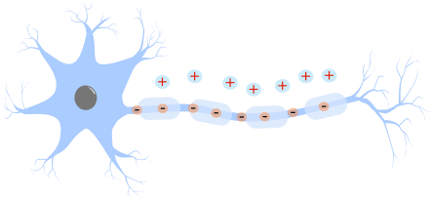
So how does a neuron send an electrical signal from one end to the other and to other neurons?
When a neuron is inactive and waiting for a stimulus, there is an electrical difference between the inside of the neuron and the outside of the neuron.
The inside of the neuron is negatively charged, whereas the outside of the neuron is positively charged.
This is its normal resting state.

Slide 25
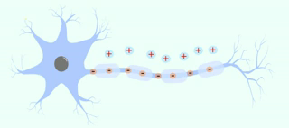
Action Potential
When a stimulus activates a neuron, the stimulus causes a movement of electrical charge across the neuron, resulting in the inside of the neuron becoming positively charged and the outside to become negatively charged.
As a result, an electrical impulse is generated which can travel down the length of the axon toward the axon terminal. This electrical impulse is called an action potential.

Slide 26
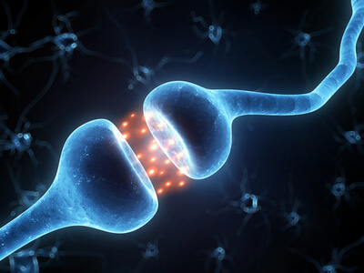
But what happens when the action potential reaches the end of the axon?
When an electrical signal is sent from one neuron to the next, the neurons are not in direct contact with each other. This means that there is a gap between neurons.
This gap is called the synaptic cleft.
So how can information be sent between neurons when there is a gap between them?

Slide 27
When the electrical impulse travels down the axon toward the next neuron, it cannot simply continue onto the next cell because of the synaptic cleft.
Instead, the signal is converted to a chemical message.
When the electrical impulse reaches the axon terminal, this triggers the release of chemicals called neurotransmitters, which are released from the axon of the neuron sending the signal. The neuron that releases the neurotransmitters is called the presynaptic neuron.

Slide 28
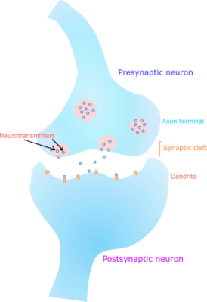
These neurotransmitters move across the synaptic cleft and carry the signal across the gap to the next neuron.
The neurotransmitters then bind to receptors found on the dendrites of the receiving neuron.
This neuron that receives the neurotransmitters is called the postsynaptic neuron.
This is how the neurons pass on information to each other!

Slide 29
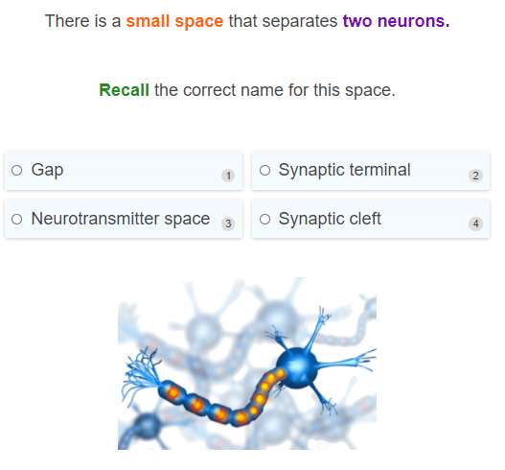

Slide 30
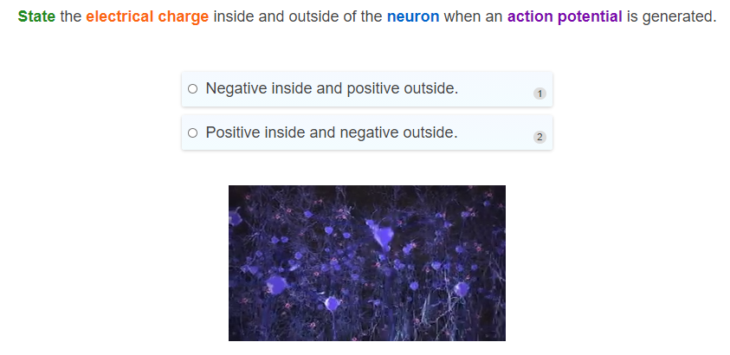

Slide 31
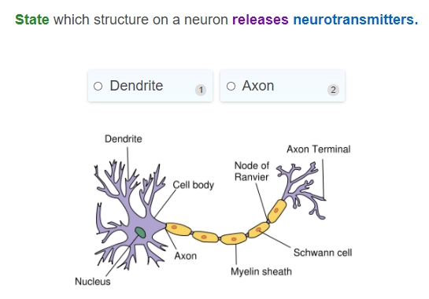

Slide 32
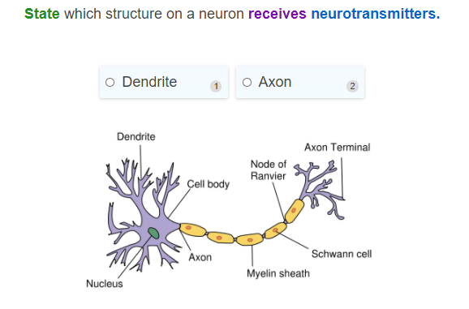

Slide 33
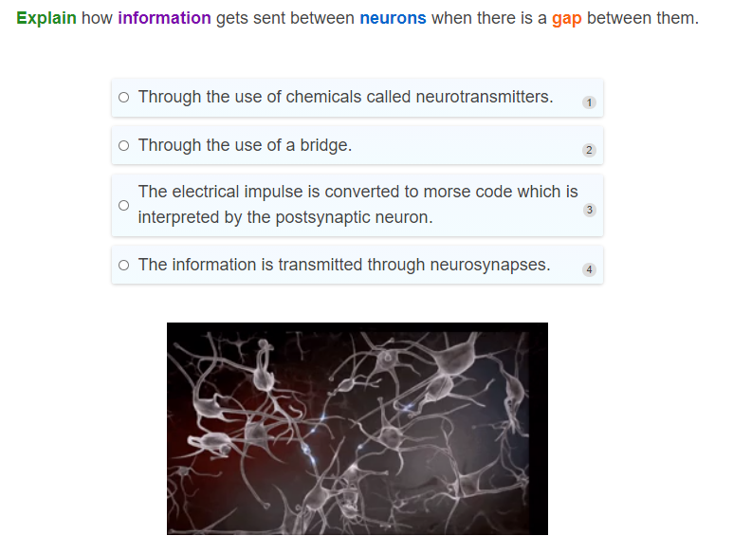

Slide 34
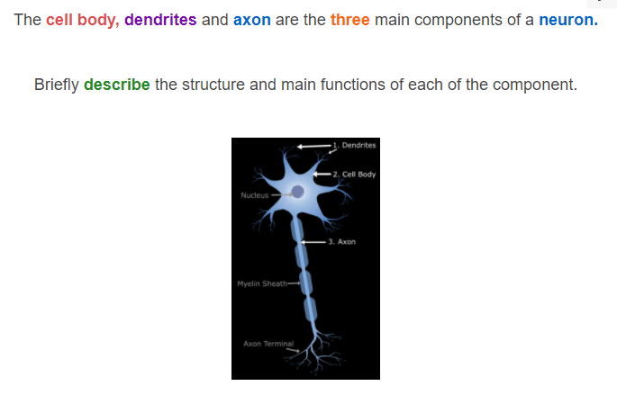

Slide 35
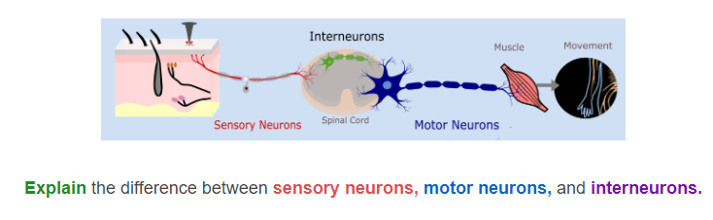

Slide 36
